Slide 1
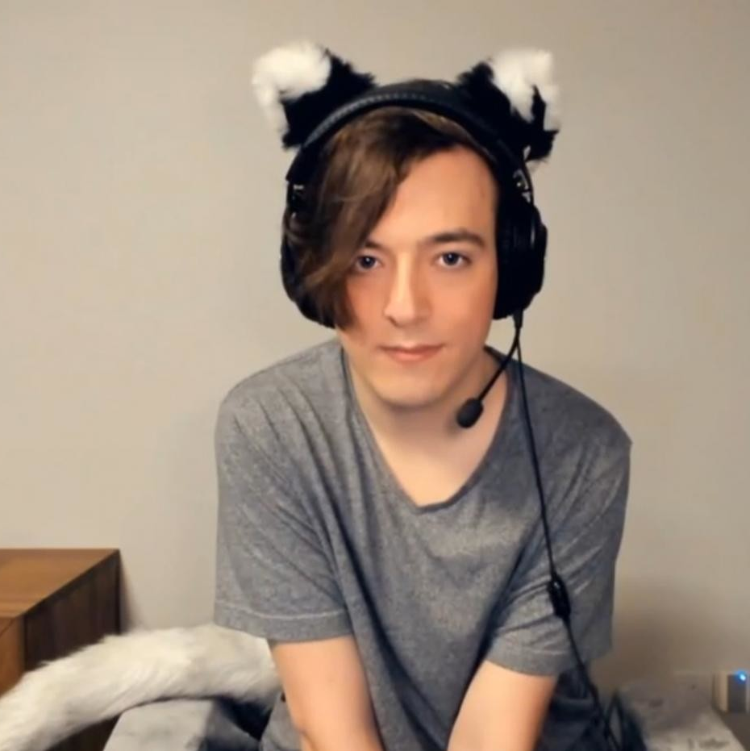


My experience in the Games Development Industry
Anthony Marmont
(they/them)
@Fydarus
Fydar
Notes:
Hiya, I'm Anthony.
I’m a former student here!
I remember sitting in those chairs watching Ben from NearLights talk 4 years ago. I got to be honest, I only remember Bens talk, so you have that to look forward to.
I’d like to talk about my experience of the Games Development Industry. I'd like to show you around the studio, and talk about my life as a programmer.
A lot of people who are considering Games Development as a career have only heard about the grind and the crunch.
I don’t want this to scare you away. I want to show you my experience, because it’s not all that.
But! it’s important not to forget, the grind and crunch can be very real. Stay vigilant. Be vocal. Don’t let bad practices grow out of control.
If you want more information on what to do to maintain a healthy work-life balance, I recommend you check @TheeDoctorB on Twitter. He’s a great chap and an even greater advocate for mental health in games development.

Slide 2
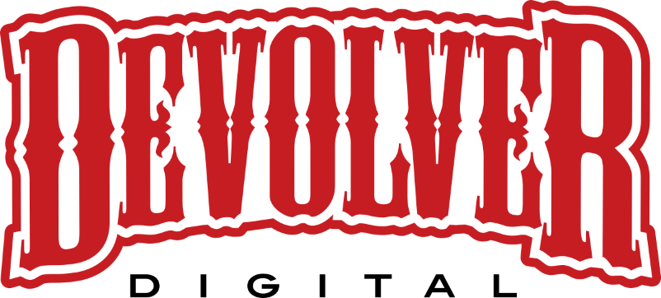
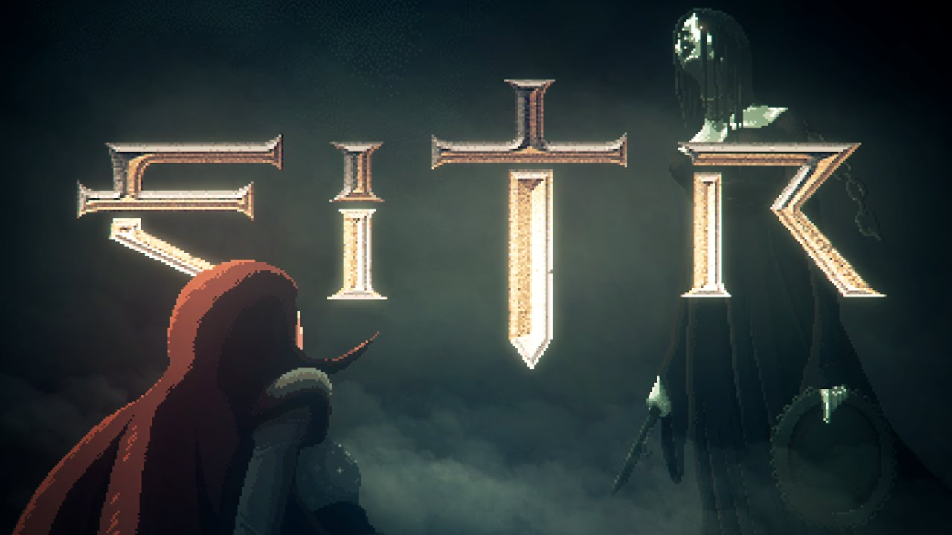
Devolver Digital
12 months (part-time)
3-5 person team
Notes:
I’ll give you a quick rundown of my career so far.
I started in it just over 4 and a half years ago doing freelance work for Devolver Digital, on an indie title called ‘Eitr’.
This was part-time whilst I was doing the Level 3 course, right here, with Rob and Cas.
I don’t tell the story of how I ended up working with them often.
I actually found the job posting on the Unity Forums and I pinged them over an email.
I was passionate about Data Driven Design which is an important part of RPG games. They hired me because of my passion.
This breakthrough job defined my career.

Slide 3

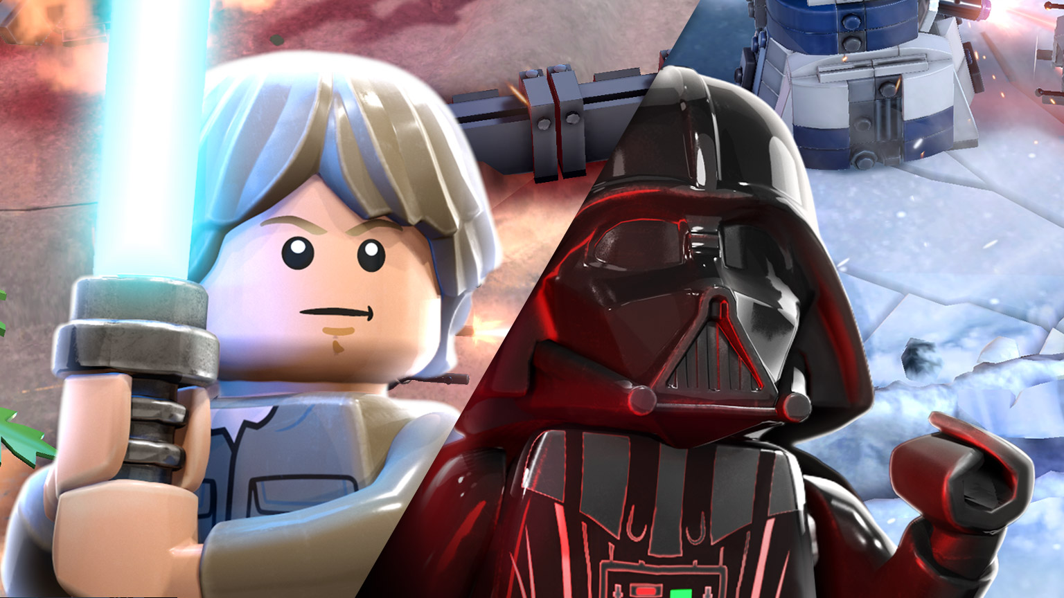
Devolver Digital
12 months (part-time)
3-5 person team
TT Odyssey
2 years, 3 months
30 person studio
Notes:
My freelance work lead me to my first in-studio job at TT Odyssey, working on a ‘LEGO Star Wars’ mobile game.
TT Odyssey are based in Brighton.
I joined these folk the Monday after I finished College.
My ex wasn’t too happy about that.
I joined their 30 person team, and I miss every single one of them.

Slide 4

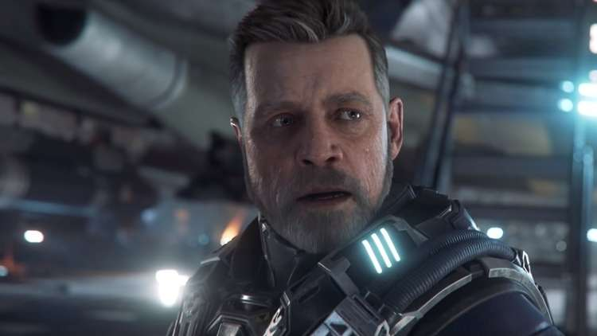
Devolver Digital
12 months (part-time)
3-5 person team
TT Odyssey
2 years, 3 months
30 person studio
Cloud Imperium Games
1 year, 5 months
700 person studio
Notes:
I’m now at Cloud Imperium Games, working on ‘Star Citizen’.
I’m coming up on 5 years in the industry now and it’s time for me to move on.
I’m currently interviewing with SO MANY places.
I’ve got offers on the table but nothing I can talk about at the moment.
So don’t expect me to hang around long.
I want to tell you what my day-to-day life in games development is like; but unfortunately nothing is day-to-day working at Cloud Imperium Games. I joined in the pandemic; so everything been remote.
I’ll primarily be focusing on my experience at TT Odyssey. I believe it will be more applicable to the industry at large.
So what did I work on a TT Odyssey?

Slide 5
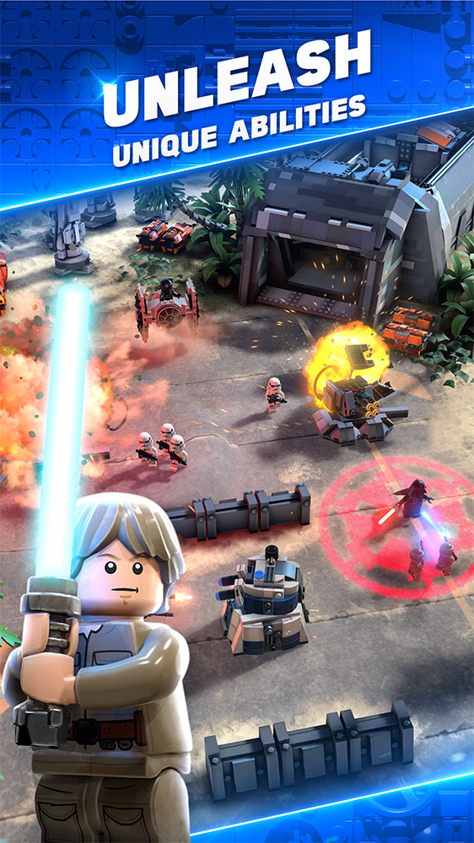
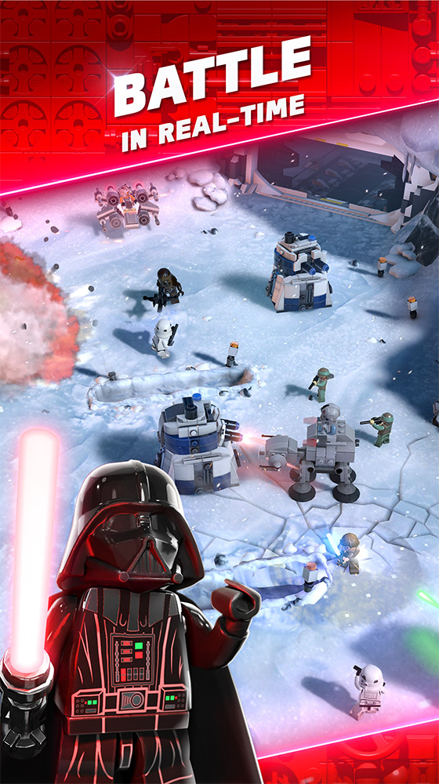
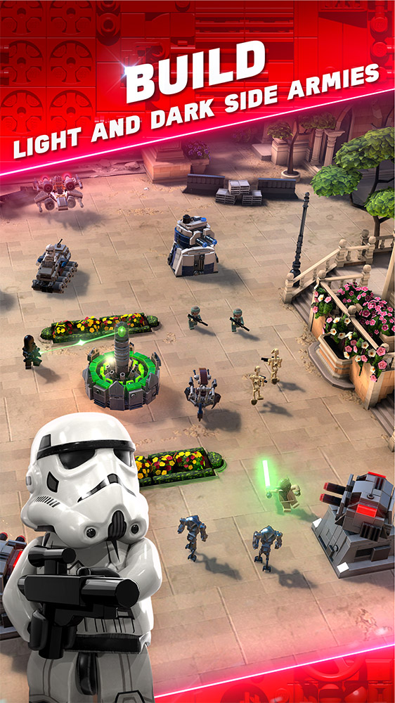
Notes:
I worked on this game. It’s called “LEGO Star Wars Battles”.
It’s a Clash Royale game with LEGO Star Wars Characters.
I would also hope it does enough to make it unique; but I’ll leave that up to you.
Since I left the game is no-longer on Android and is now an Apple Arcade published game.

Slide 6
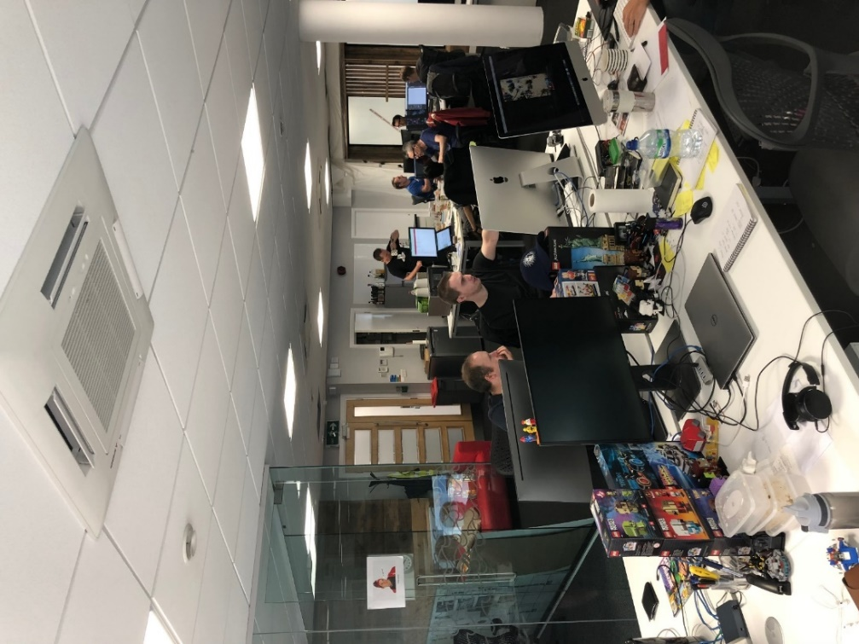
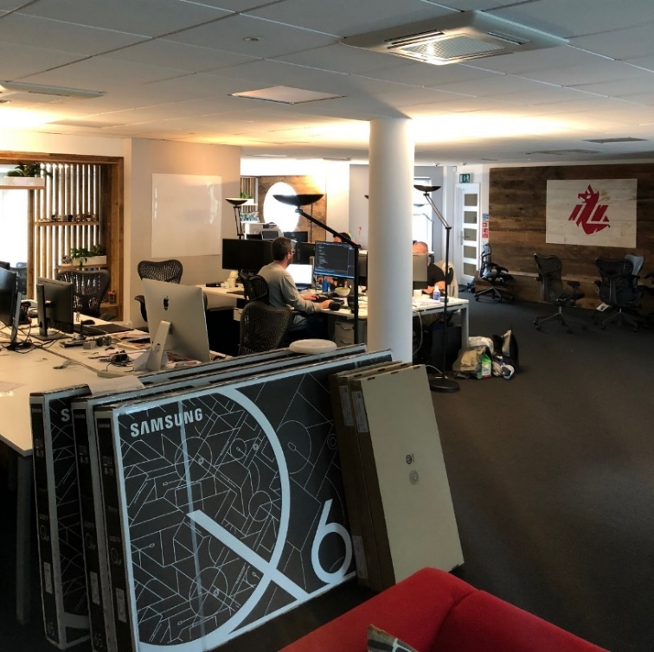
Notes:
So this is where I work. The office looks quite messy in these photos. The whole office was forced into just one half whilst we remodelled. This was when we had to put the microwave and toaster on Matts desk, and if we used both of them at the same time then we would loose hundreds of hours of work as every one on our floor looses power. I would also toast hot-cross buns for lunch and make everyone jealous. There was also a STRICT no-fish policy. Don’t be that person who microwaves fish.

Slide 7
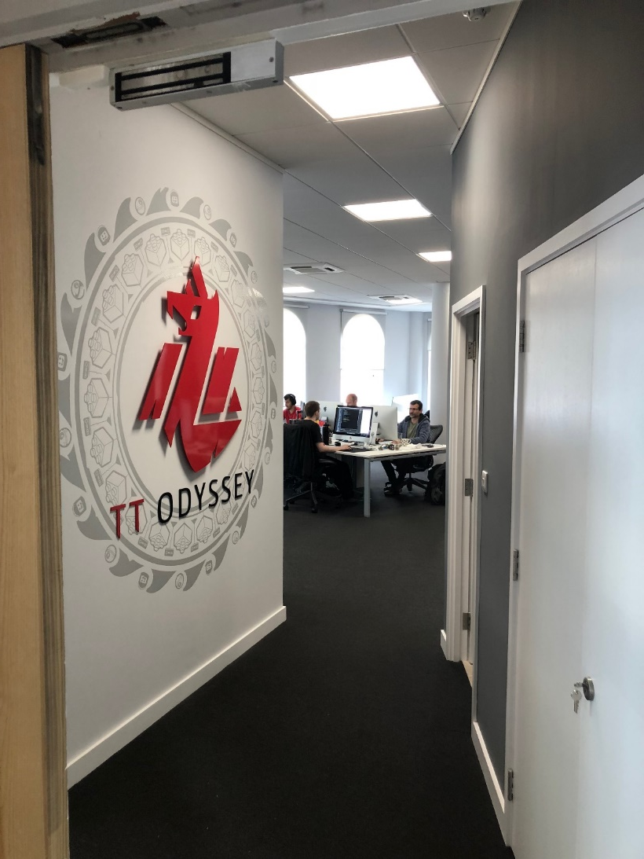
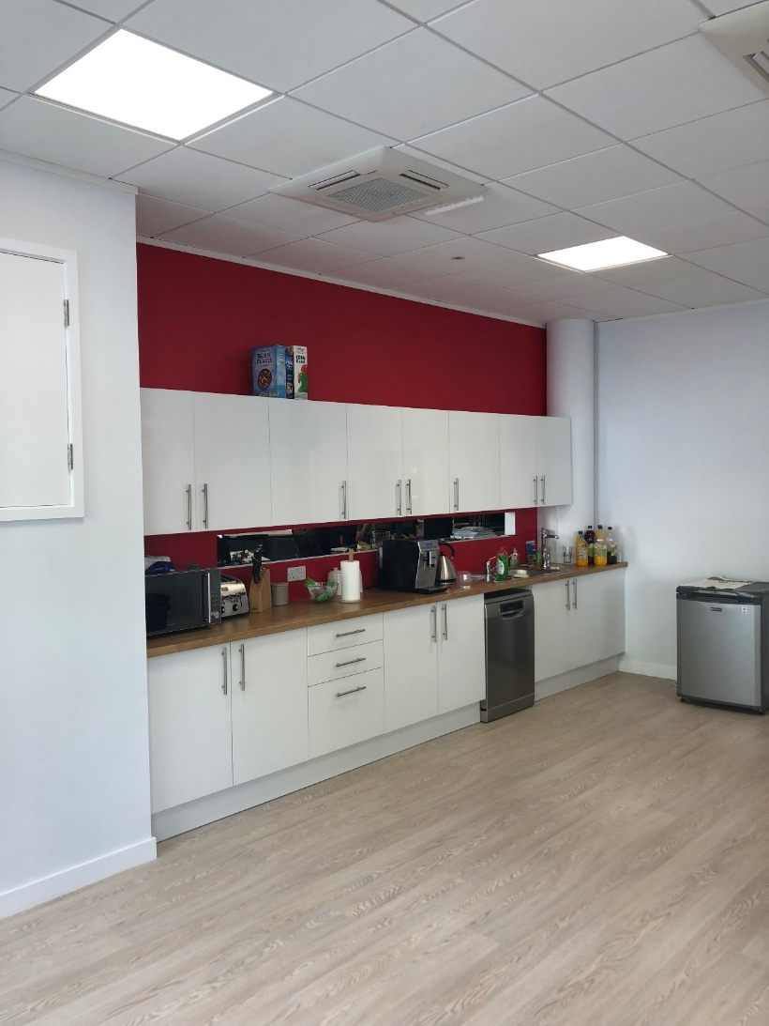
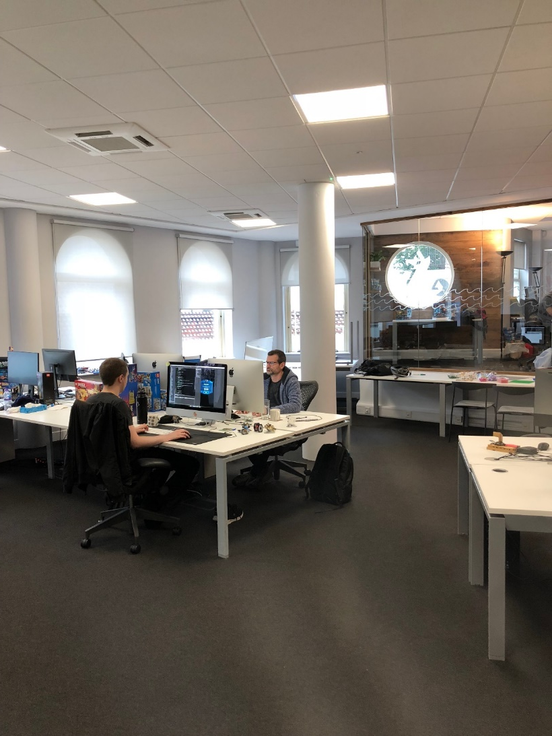
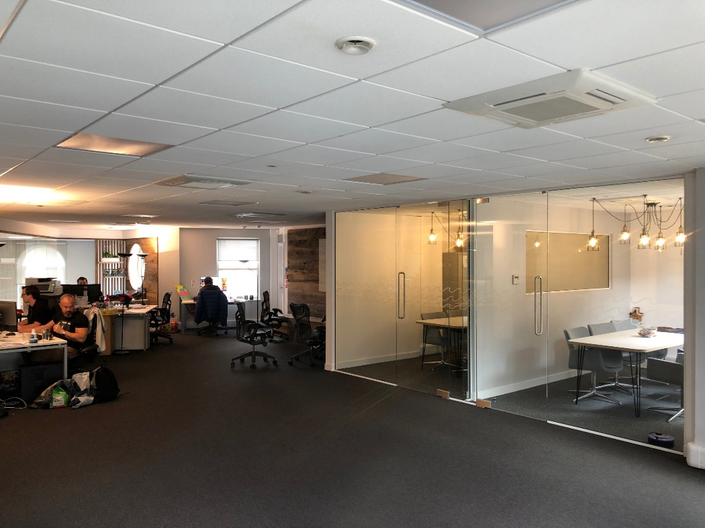
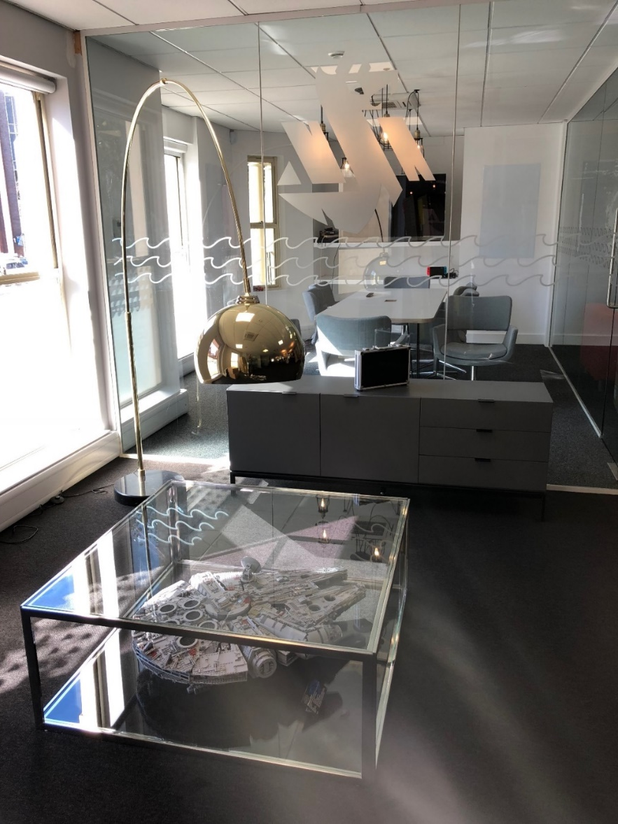
Notes:
Here’s some photos after we finished our remodelling.
We got a nice kitchen, sofa area, and some "Interrogation Rooms”.
The perks of working with LEGO is you get a TON of free LEGO. We would hold quarterly raffles for the free LEGO sets that where sent to the office and the rest we would donate to local charities.
You can see the LEGO millennium flacon under that coffee table.

Slide 8
The Games Industry and You
I’m here to…
help you feel confident in the industry.
Responsibilities
Safety Nets
Notes:
Normally, I tell everyone what my day looks like, but this typically involves a lot of time talking about meetings…
Don’t get me wrong, meetings are cool! But not everyone will agree…
That’s my goal! To help you feel confident in the industry.
I don’t have a silver bullet, but I can share with you some insights from the industry.
Along the way I’m going to try and tell you what responsibilities you might have at a studio, and what safety nets exist.

Slide 9
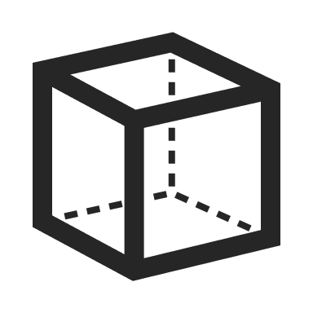




Responsibilities
Practical
Art
Code
Design
Audio
Notes:
Lots of the work I do is practical.
Unfortunately, for those of you who aren’t programmers; I am one.

Slide 10
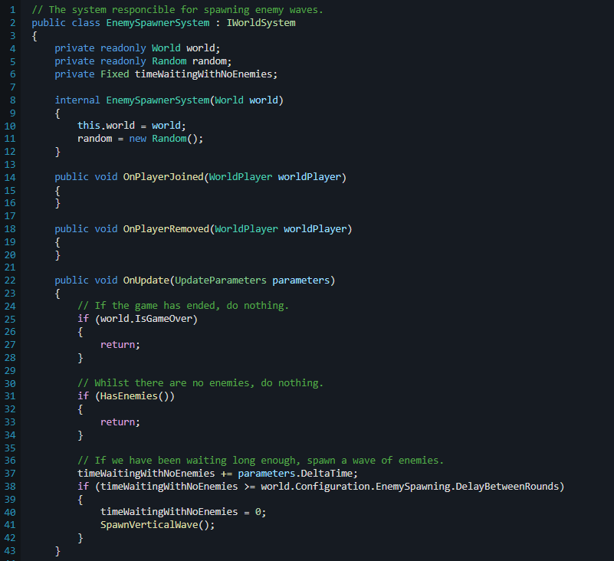
Responsibilities
Practical
Programming
Notes:
I will be able to talk about some of the specifics of programming
but everything I’m saying applies directly to other roles as well.
I will put my headset on and program non-stop for hours.
We even had a phrase in the industry that goes “headset-on work”; meaning to set aside time not to be disturbed so you can get lots of practical work done.
It's a good idea to get other people involved when your doing stuff
so that other people can understand how it works and it stops you focusing too much on one thing.
I enjoy the amount of freedom I get when I’m writing systems from the ground up.
But you have to be careful to make sure your not over-engineering.

Slide 11
Responsibilities
Practical
Programming
Pair Programming
Notes:
Are you struggling with your work?
It’s okay. You’re never alone.
Sometimes it takes more than one person to solve a problem.
Whether it’s programming, art, design, e.t.c
In programming, we often employ Pair Programming to solve problems.
Pair programming is when two programmers are working on the same workstation at once to solve a problem.
This is often helpful to spread information about a piece of code that you might be stuck on.
You get to bounce ideas off of one-another and benefit from their insights into the code.

Slide 12
Notes:
When I talk about Pair Programming, I’m reminded of this horrendous scene from NCIS, where there’s two people typing on the same keyboard.
Let me just… Ahhh, there we go…
Christ, how did this ever make it to air.
It’s nothing like this.

Slide 13
Responsibilities
Practical
Programming
Pair Programming
Your never alone.
Notes:
If you ever get stuck, don’t try and burden the weight of all the work by yourself.
Reach out to your co-workers and your producers.
Producers LOVE to hear that you are encountering problems as early as possible.
You are never alone.
At the end of the day, all of your co-workers are people too.
For now, that’s all I will say on the practical elements of work.
But don’t worry; I have allotted some time at the end to ask any questions about practical work.

Slide 14
Responsibilities
Practical
Leadership
Notes:
Other responsibilities include leadership-orientated work.
It's a bit intimidating at first, but I really enjoy it.
It’s not for everyone though, and that’s fine.
There's industry juniors and veterans at my office who choose not to do leadership, and get on with the practical work instead; and there’s myself and others that like to take a big task off of the producers hands and delegate it to people.
Developers who take on these big tasks are often called “Feature Leads”. This person is expected to be the go-to person for that feature. If anyone has questions about that feature, they will direct them towards you.
I was the “Feature Lead” for Clans, Leaderboards, and Battle Metrics, along with other game systems.
If anyone wanted to know the progress of any of these features, they could come to me,
or talk to the producers who I keep regularly updated.
As feature lead, you are responsible for the feature you work on. It’s your job to make sure that the feature meets deadlines for it’s development, testing, and release.
If these deadlines aren’t being met; they need to let producers and other stakeholders know ASAP.
Being a feature lead is a great way to get experience leading teams of programmers and even developers in other departments
and this opportunity is often open to all developers, regardless of title.
At TT Odyssey, our feature Leads often have spare chairs at their desk for visitors. They get them a lot.
But like I said, this responsibility has always opt-in.
It’s a good stepping stone towards jobs as a Department Lead, if that’s the sort of work you are interested in.

Slide 15
Responsibilities
Practical
Leadership
Planning and Theory
Notes:
Ahhha! I enjoy this part! The planning and theory!
I enjoy this part because when it’s done right, it really shows. When it’s done wrong, it can have devastating effects on the project.
Planning can be broken down into a couple of rounds.

Slide 16
Responsibilities
Practical
Leadership
Planning and Theory
Feature Planning
Notes:
Round 1: Feature planning!
At my office, a feature lead will take the design Spec, sit down with the feature team (that’s the team the feature lead runs) and then we each present our plans to each other for how we might go about implementing the feature.
Design will ask for stuff. And if you do that stuff without understanding why you are doing that stuff; you might miss something fundamental.
So you have to make sure you ask the right questions. This is where you really get to apply critical thinking.
For example, design has asked for a new reward to be added to the game for dealing damage to the enemy.
- You might highlight that this encourages an aggressive playstyle and harms the more relaxed players.
Or you might highlight that there exists enough mechanics in the game to do an INFINATE amount of damage, and thus gaining infinite rewards.
Then it’s designs turn to get mad and go think of a solution.
This is where the process of “Iterating on design” comes into play.
This can involve breaking the design spec into smaller parts, committing only to a vertical slice or MVP implementation; or completely change up the design of the feature.
This is also an opportunity for people in all departments to voice their concerns with the design, and contribute towards the design.

Slide 17
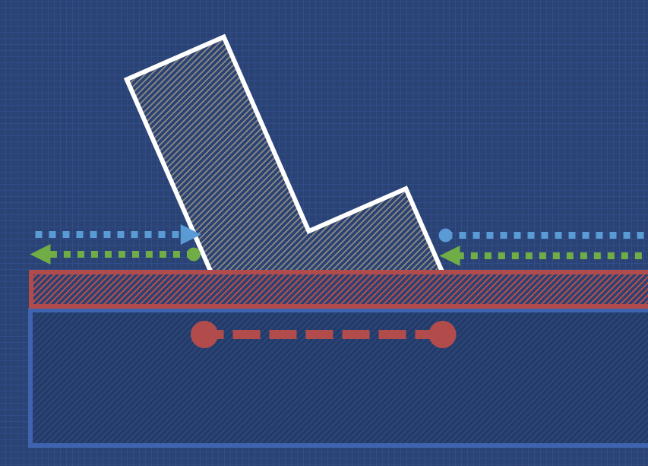
Responsibilities
Practical
Leadership
Planning and Theory
Feature Planning
Technical Planning
Notes:
And now we’re onto Round 2: Technical Planning
Before embarking on a implementing a big system of piece of code, many studios will have a process for creating a TDD (a technical design document).
You may write the technical design documents yourself, or you may write them collaboratively.
If you are ever struggling to know what to do next, you always have your technical planning to hand.
If in your work you encounter issues, you can always go back to the drawing board with what you have learnt and create a new technical plan.
This is a powerful tool.
Once you have your TDD, you can present it to your line manager or the Tech Director, who will be able to approve it for work.
I could talk about this for ages, but it’s probably a good idea to move on.

Slide 18
Responsibilities
Practical
Leadership
Planning and Theory
Ideas and Playtesting
Notes:
This is the “I can’t believe they are paying me to do this” kindof work.
Quite often we will all install the latest build onto a device and sit in our sofa area and just play the game.
It’s great fun competing against each other.
Lots of great ideas come from this.
We will often have the design team grab their notebooks and constantly be scribbling down notes during these play sessions.
We have separate teams working on different versions of the game.
Playing those versions and comparing them to the game that’s currently out in the world is really exiting.
Look out for studios that make play testing a regular part of the studio.
This is something you want to be able to get involved with as much as possible. It’s a really good sign that a studio is passionate about their product.

Slide 19
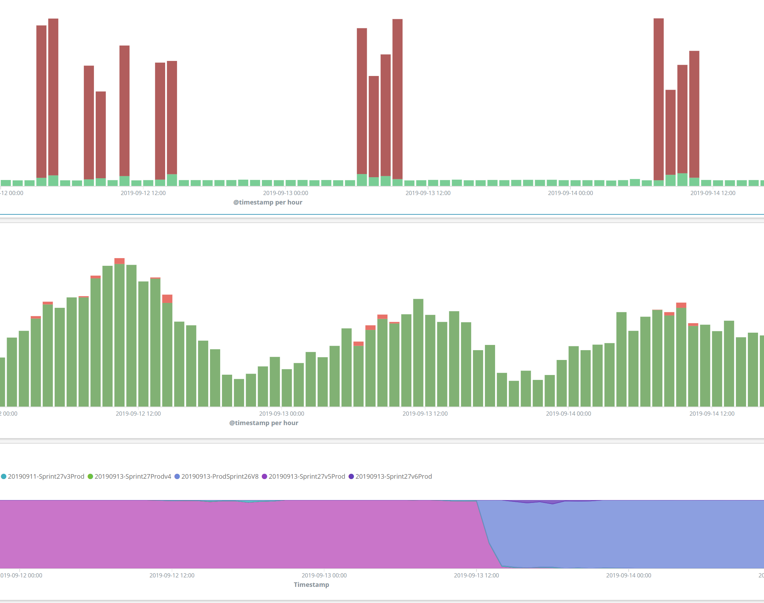
Responsibilities
Practical
Leadership
Planning and Theory
Ideas and Playtesting
Live Ops
Notes:
LiveOps is a responsibility that only myself and 2 other people have at TT Odyssey. That’s the responsibility of my team, the Server Team.
LiveOps is maintaining our live servers.
It’s checking the logs to make sure there’s no errors.
And it’s being one of the 3 people at the studio who can actually fix the servers if something goes wrong.
That screenshot is from our logs; from our live servers; which would occasionally encounter these periods of 500 errors.
I never solved what caused this bug. It haunts me in my dreams.
Working LiveOps does mean there’s a change you’re getting called at 2am if an alarm is triggered and the servers are dying. That hasn’t happened yet, though!

Slide 20
Responsibilities
Practical
Leadership
Planning and Theory
Ideas and Playtesting
Live Ops
Mentoring
Notes:
Then we have mentoring.
Mentoring is such an important part of studio culture.
Make this something that you look for in your future studio.
Having a studio culture that incorporates mentoring has been great for everyone at my office.
Everyone has someone to go to, and to talk to.
Every month, a mentor and their mentee sit down with for a couple of hours and you can just have a pretty chilled conversation.
You could be about the weather; what you where up to at the weekend; stuff that you encountered at work; it doesn’t matter.
Mentors are also a great person to go to when it comes to conversations about career goals.
A mentor can be empowered to talk on your behalf to your line manager about promotion goals.
It’s sometimes easier to talk to a peer than it is to talk to your boss.
A mentor is just another way that you are never alone.
If you need support, they are a great person to go to.

Slide 21

Responsibilities
Practical
Leadership
Planning and Theory
Ideas and Playtesting
Live Ops
Mentoring
Interviewing
Notes:
When TT Odyssey was recruiting, something that I also done was resume screening and interviews.
It taught me a lot about what makes a good resume.
What we did is we sat down with a highlighter and go through it, picking out the key facts. University, experience, relevant skills, e.t.c. And then we write down some notes.
We then presented the resume we had been reading to the rest of the team in the meeting room.
During University-season we would have around 10 resumes a week to screen.

Slide 22
Responsibilities
Practical
Leadership
Planning and Theory
Ideas and Playtesting
Live Ops
Mentoring
Interviewing
Notes:
I hope that, with this list here, you can see that
your value at a studio is decided not just by your ability to model or program. Your practical ability.
Your value at a studio is decided by your ability to engage, communicate, and so much more.
Your not a machine that takes in coffee and outputs work.
And if a studio doesn’t appreciate that, they aren’t using you to your full potential.
And that’s on them.
It can be easy to bury your head in practical work.
This industry has so much more to offer.
So…
Does this sound like something you might enjoy?

Slide 23
How do I get into the industry?
Your first job…
Game Jams!
Notes:
You may be asking, how do I get into the industry?
Everyone has their own path, but I can share you mine.
Once you have gotten your first job in the games development industry; you can leverage this to grow your career.
But, getting this first job in industry can often be quite challenging.
Quite simply, for your first position in games development; employers need to see passion.
And the best way to show passion is through game jams!!! They are incredibly important.
If you send me your resume and you don’t have a single game jam on your portfolio, your resume is going in the bin.
If all your work is from College or University, your resume is going into the bin.
It sounds harsh, and it is.
You don’t have to do any of the official or organised ones, you can set yourself a game jam if it helps.
But please, do game jams.
As for myself, I got into the industry with just my game jams and personal projects, along with my first-year FMP

Slide 24
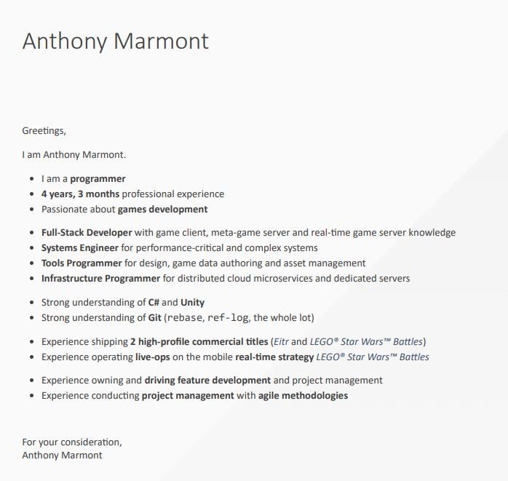
My Cover Letter
I’m not saying it’s good!
After going through a lot of CVs, I found that this really helps!
Experiment and find out what works for you. Everyone has unique experience.
Tailored to the job posting.
Notes:
I have seen a lot of resumes now.
I’ve highlighted a lot of the same words.
From my experience, something like is pretty helpful. This is what my cover-letter now looks like. It’s everything that I would sit down and highlight right on the front.
Since it’s my cover letter, I can also tailor some of the key points to the job from the job posting.
And I know there’s no risk of someone missing something when they go through with a highlighter.
Almost every time I’ve handed in this CV; I’ve got a response; but this is still very-much work in-progress stuff for me.
You have to experiment and find what works best for you.
My biggest piece of advice when it comes to CVs: DON’T RATE YOUR SKILLS. Don’t do fancy bars or stars where you rate your skills our of 10 or whatever. Just don’t do it.
I can talk in detail more about why; but I think instead I’ll just share what happened to a poor candidate who did. I was interviewing applicants for a Grads in Games award and one applicant rated their skills. Upon entering the interview room; the former Apple Tech Director sitting next to me tore their CV up in-front of them (and proceeded to bluntly ask “Why should I hire you?”.)
He was ruthless.
I asked after when the candidate had left the room why he was so rude to that specific candidate.
He picked up one of the shreds of paper and pointed at it.
“They rated their skills.”

Slide 25
Take a breath…
Notes:
I’ve been talking pretty much non-stop now for god knows how long.
And by God I mean Rob, probably.
I hope that you now know more about the industry.
I hope that you now know that there are safety nets at every point in your work.
And that there are opportunities for you to grow.
And most importantly.
I hope you can see that your value is more than just your code, or your art.
This is a good industry to work in.
I hope if you had any hesitations about perusing a career in games, that I’ve helped ease them.

Slide 26
Questions?
You can find this presentation at
fydar.github.io/careers-2022.pptx
Anthony “Fydar” Marmont
(they/them)
@Fydarus
Fydar
Notes:
Unfortunately, I don’t know any inside details from ‘Star Citizen’.
If you follow the Reddit, you know more than me.
I find out about new planets being released by Googles News.

Slide 27
Thank you.

Slide 28
This is the end of the presentation…

Slide 29
You can go away now.

Slide 30
Ah, you’re still here?

Slide 31
Waiting of the post-credits?

Slide 32
Sorry, there’s no post-credits here.

